Slide 1
Fun with ADS-B
Luke Starnes
@slstarnes
lstarnes.com

Slide 2
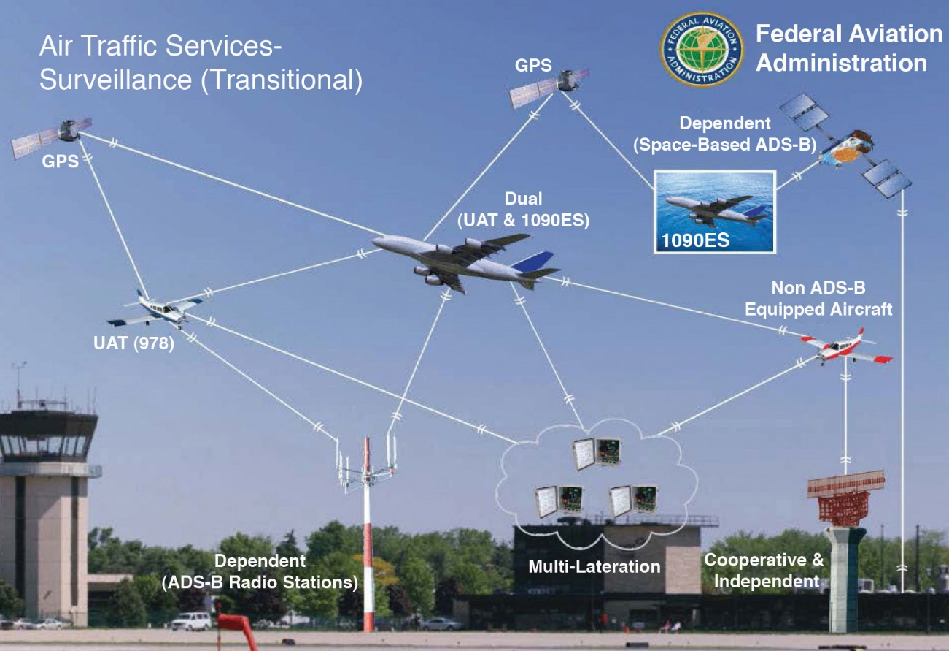
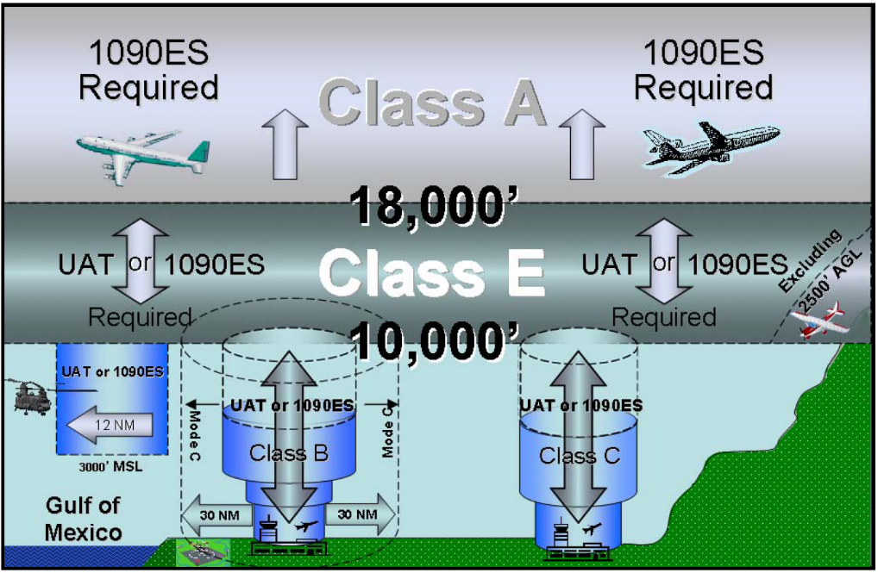
Automatic Dependent Surveillance—Broadcast (ADS–B)
ADS-B mandated in US starting Jan 1, 2020
Europe’s mandate begins January 1, 2019
Mandated about 10k’ and around airports or out Gulf of Mexico
ADSB operates at either
1090 MHz or 978 MHz (US Only)
Notes:
1090ES –ADS-B messages using Extended Squitter transmitted on 1090 MHz (EU and US)
978 UAT – Universal Access Transceiver on 978 MHz (US only, General Aviation use)
ADS-R – ADS-B messages rebroadcasted from the ground on the opposite frequency on which it was received to be used to increase situational awareness
TIS-B – Traffic Information Services Broadcast containing air traffic information concerning all traffic in the area including non-ADS-B equipped aircraft
FIS-B – Flight Information Services Broadcast containing ground to air meteorological and aeronautical information (978 MHz only)

Slide 3

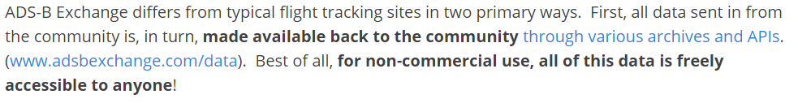
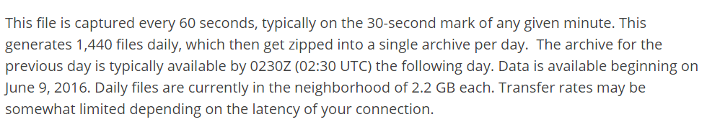
Data Gathering
Grabbed 245 days of data
~540 GB
Each day is 1 zip file containing 1440 json files
Uncompressed this is ~10.9 GB per day

Slide 4
Data Prep
Converted the json files to HDF5
Each minute : ~1.45Mb
Each Day: ~1.8 Gb
Minute (json)
Minute (hdf5)
Day (hdf5)
Day (zip)
540 GB 2.6 TB 500 GB 441 GB
Initial: 540 GB
Intermediate: 3.1 TB
Final: 441 GB

Slide 5
Queue Notebooks

Slide 6
Final Thoughts
Data Provider:
www.adsbexchange.com
Toys:
Jupyter Notebook
Pandas
HDF5
Bokeh
Datashader
Almost Toys:
Holoviews / Geoviews
Luke Starnes
@slstarnes
lstarnes.com

